Slide 1
ARE YOU READY
FOR A JOB?
Employment Readiness Workshop
10th Grade English Class
Casa Grande High School
Developed and Presented by the Casa Grande High School
Counseling Department

Slide 2
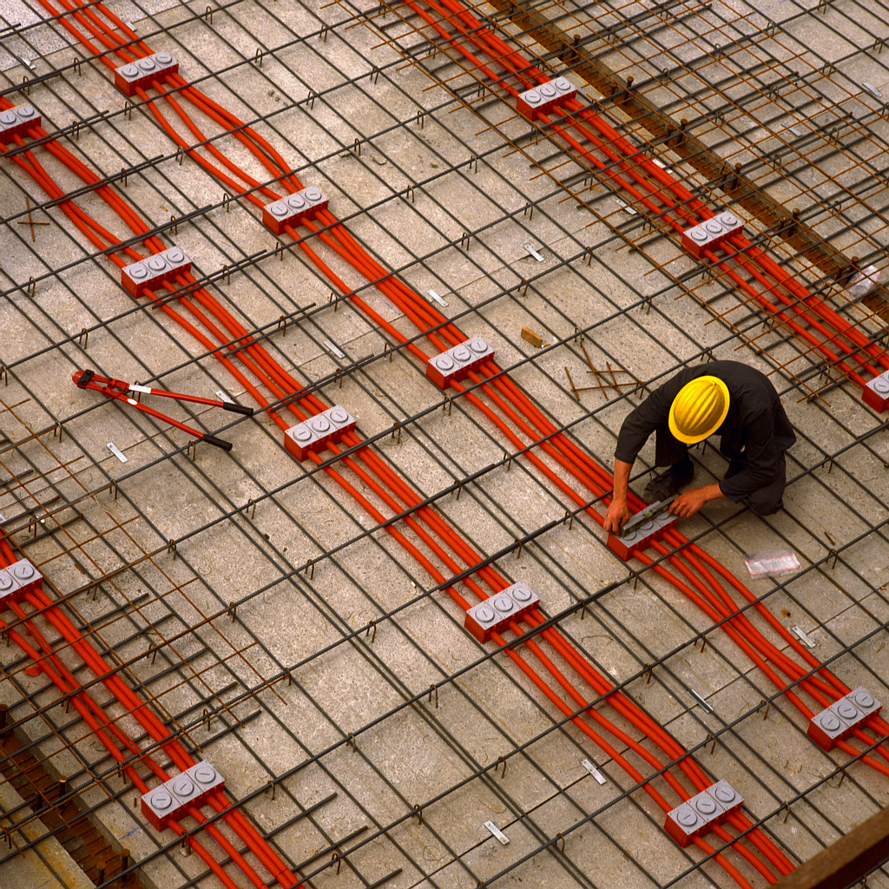
Who is Eligible to Work?
Age Restrictions
Work Permits (What, Where, How?)
Documentation Needed
Child Labor Laws
Minimum Wage
Employee vs. “Under the Table”
Age Restrictions
Work Permits (What, Where, How?)
Documentation Needed
Child Labor Laws
Minimum Wage
Employee vs. “Under the Table”

Slide 5
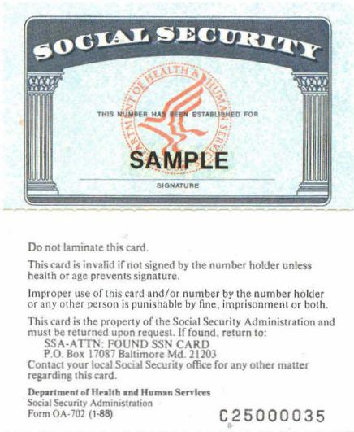
Social Security Card

Slide 6
California
Minimum Wage

Slide 7
Federal
Minimum Wage

Slide 8
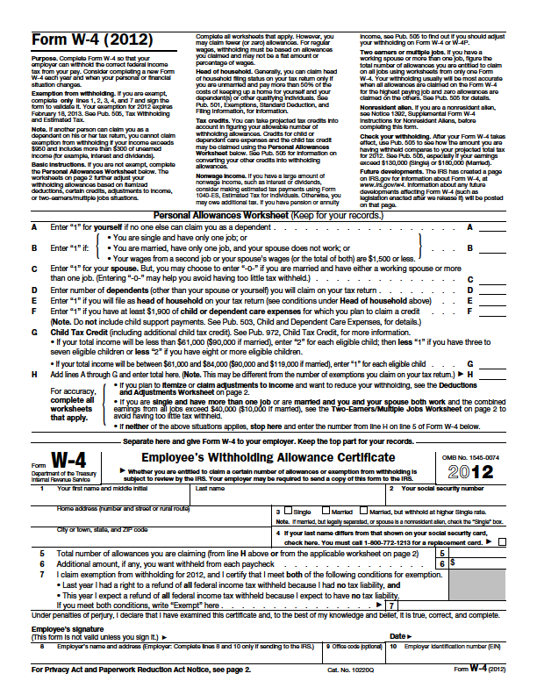
IRS Form W-4

Slide 9


Slide 10


Where and How do I search for a Job?
Word-of-mouth
Internet (local sites, company sites, national sites
CGHS Career Center
Job Placement Office (SRJC, Sonoma State and COM)
Newspaper
www.craigslist.org
http://www.pressdemocrat.com/section/jobs

Slide 11

EMPLOYMENT APPLICATIONS
Fill out entire application (No blanks!)
Make a copy of the application for a rough draft
Always use Blue or Black ink (No pencil!)
DO NOT: Roll, fold or Staple the application
If possible: Hand Deliver the application to a Manager
Check social networking pages for “clean” content
Use professional email address moniker

Slide 12
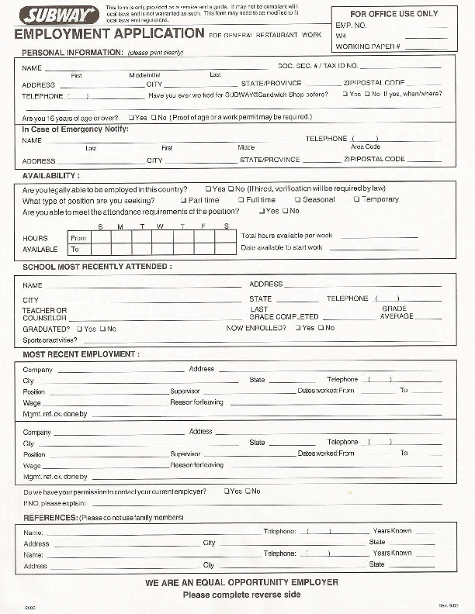

Slide 13
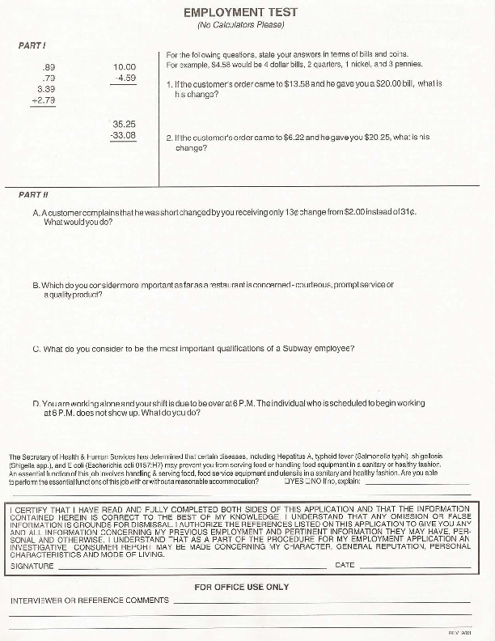

Slide 14

Salary Desired
Starting Salary
Rate of Pay
=
NEGOTIABLE
ne⋅go⋅ti⋅a⋅ble
nɪˈgoʊ ʃi ə bəl, -ʃə bəl/ Show Spelled Pronunciation [ni-goh-shee-uh-buh l, -shuh-buh l] Show IPA
–adjective 1.capable of being negotiated: a negotiable salary demand. 2.(of bills, securities, etc.) transferable by delivery, with or without endorsement, according to the circumstances, the title passing to the transferee.

Slide 15
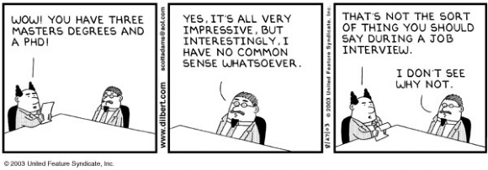
Interviewing for a Job
Preparation: Review common questions and Research the Organization
Proper Attire, Hygiene, Etc.
Arrival
In the Interview: Do’s and Don’ts
Conclusion of Interview
Follow up: Thank You Letter and Contact

